Slide 1
All About Functions
Creative Commons Attribution-NonCommercial-ShareAlike 3.0 Unported License. http://creativecommons.org/licenses/by-nc-sa/3.0/
Written by Rachel J. Morris, last updated 2015-01-24

Slide 2

Functions are an important part of programming, so there is a lot to cover this time.
Functions are an important part of programming, so there is a lot to cover this time.
Pay attention to the vocabulary of functions. Understanding the vocabulary is important so that you can clearly discuss functions with other programmers.

Slide 3
Functions allow us to pull functionality into separate areas of the program, so we don't have a big, cluttered mess in main().
And because Functions have names, they also allow us to keep our program clean by describing what the code inside a function does.

Slide 4

What is a function?

Slide 5
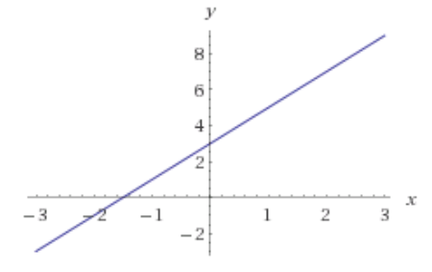
What is a function?
f(x) = 2x + 3
In math, we use functions a lot.
x | f(x)
0 | 3
1 | 5
2 | 7
x is a variable we plug into the function f(x), and we get some output (which usually is a y coordinate)
Graph generated with Wolfram Alpha

Slide 6
What is a function?
f(x) = 2x + 3
float f( float x ) { return 2x + 3; }
Functions in C++ look similar to in math, except that we need to specify data-types for the return value of the function and for the parameter.

Slide 7
What is a function?
f(x) = 2x + 3
f(x) = 2x + 3
float f( float x ) { return 2x + 3; }
Data type of the returned value
Parameter data type and name
Function body
Function name

Slide 8
What is a function?
int main()
{
cout << "Hello, World!" << endl;
return 0;
}
Our main() is a function. Notice that we specify its return-type (an integer), and at the end of the program, we return 0; close the program.
However, we don't call the main() function ourselves.

Slide 9

What is a function?
When we write a function, we will specify:
Output: What kind of information will be returned (int, float, bool, nothing, etc.)
Input: What kind of information will be “passed in” to work with.
The name of the function, which we will use to call it from other places in the program.
Function name:
Slope
Input:
x1, x2, y1, and y2. (floats)
Output:
The slope between the two points. (float)

Slide 10
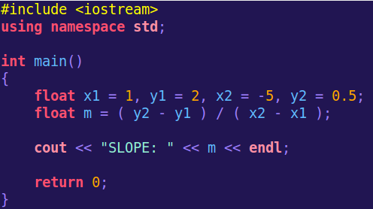
What is a function?
So far, we've been writing all of our code within main.
If we want to calculate slope more than once, we have to keep re-typing the formula.
The more you write duplicate code, the higher the chances of causing errors, like...
When making changes to the formula, forgetting to update certain spots.
Accidentally making a typo in one of the areas, resulting in a logic error.

Slide 11
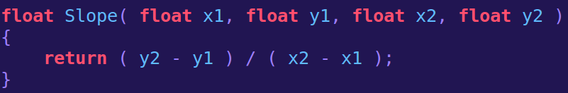
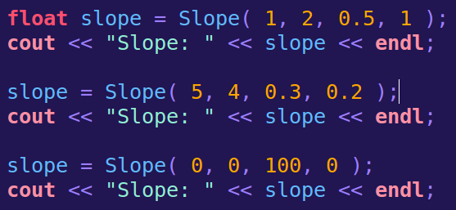
What is a function?
This also keeps our code cleaner, because now we have a function name, that describes what is going on with the code on the inside.
We can write a function to do our calculation for us, and then we simply need to call Slope any time we need to calculate it:

Slide 12

What is a function?
You may have already used some functions that are part of the C++ standard library, such as:
rand() takes no input, but will return an integer output.
sqrt() takes an input of type double (but you can pass in an int, float, etc.)
And will return a double, which is the square root of the value passed in.

Slide 13
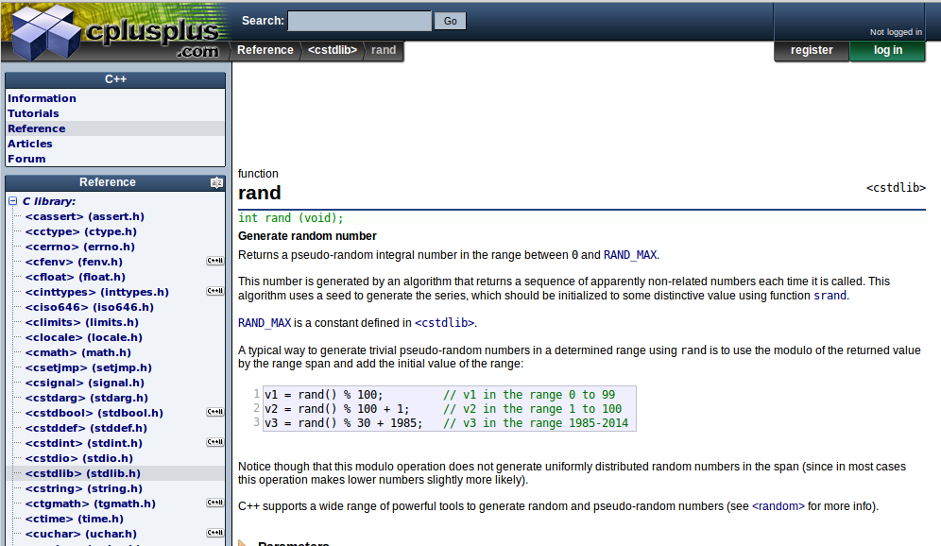
What is a function?
You can look up these functions on the
cplusplus.com reference website.
It will tell you the input, output, and sample code.

Slide 14
Anatomy of a Function

Slide 15

Anatomy of a Function
Function Declaration
Function Declaration
A function declaration is simply telling C++ that there will be a function, with some name and parameters, but the function declaration does not contain the internal code.
It is similar to a variable declaration, because it ends with a semi-colon.
However, it still contains parenthesis and a list of parameters.

Slide 16
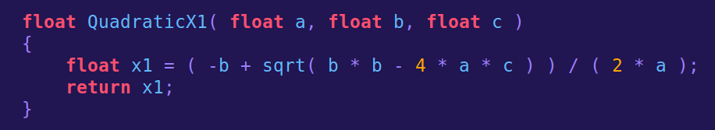
Anatomy of a Function
Function Definition
Function Definition
A function definition is where we actually add code to the inside of our function.
The function body is contained within a pair of curly-braces, { and }, and does not have a semi-colon at the end.

Slide 17
Anatomy of a Function
Function Header
Function Declaration
Function Definition
The line that specifies the function return type, function name, and function parameters, is called the function header.

Slide 18
Anatomy of a Function
Function Parameter(s)
The variables listed within the ( and ) of a function declaration or definition are called parameters.
Here, a, b, and c are parameters.

Slide 19
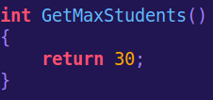
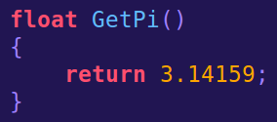
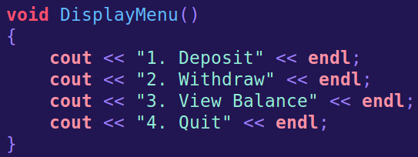
Anatomy of a Function
Function Parameter(s)
A function isn't required to have parameters.
If the function does not need any input, the parenthesis are empty.

Slide 20
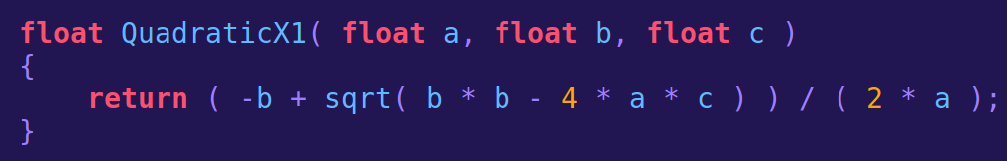
Anatomy of a Function
Function Body
The function body is the code contained within the curly-braces { }.
This is the code that will be executed any time the function is called.

Slide 21
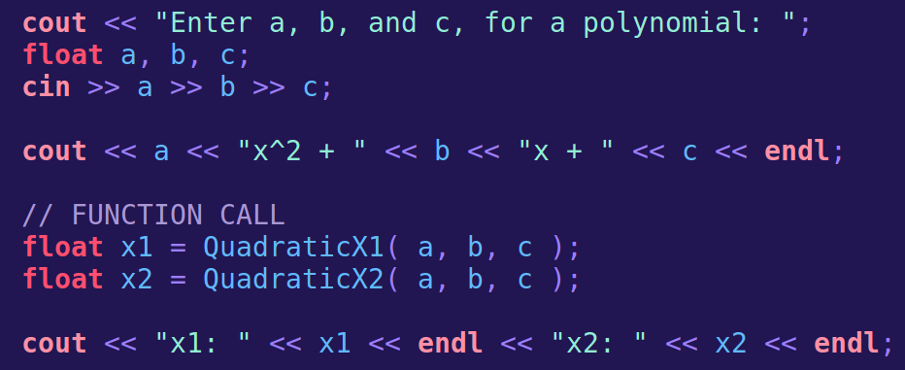
Anatomy of a Function
Function Call
A function is called whenever we use its name within the program, and pass arguments to that function.

Slide 22
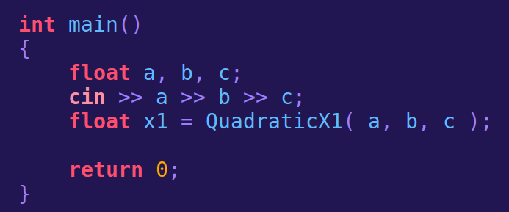
Anatomy of a Function
Function Call
We can store the return value of our function in a variable. Here, the function calculates one of the x solutions, and we are storing it in the variable x1.

Slide 23
Anatomy of a Function
Function Call
In our main(), we have declared a, b, and c.
We pass the values of a, b, and c to our QuadraticX1 function as the input,
And we get the output based on the quadratic formula.
When we are calling a function, the variables we pass into the function are called
arguments

Slide 24
Anatomy of a Function
Function Call
When we're writing our function definition, the input values the function is expecting is called
parameters

Slide 25

Anatomy of a Function
Parameters vs. Arguments
Function Call (Arguments)
Arguments
The variables, that we are passing as input to the function.
Function Definition or Declaration (Parameters)
Parameters
The input that the function is expecting.
It may seem confusing, but try to remember the difference!

Slide 26
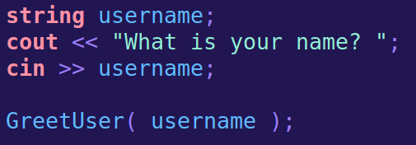
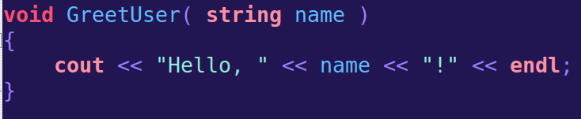
Anatomy of a Function
Parameters vs. Arguments
Additionally, the names of the variables passed in as arguments do not need to match the names of the parameters.
Function Call (Argument)
Function Definition or Declaration (Parameter)

Slide 27
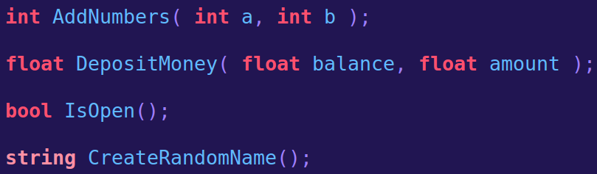
Anatomy of a Function return types
Any data type we can use for variables, we can also use as a return type for our functions.

Slide 28
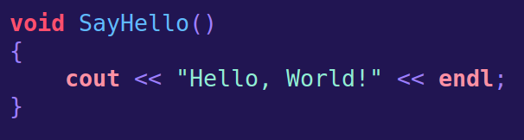
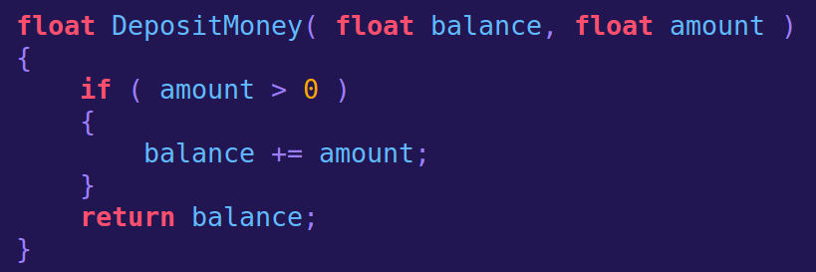
Anatomy of a Function return types
If we want to create a function that does not return anything,
We use a return type of void. Then, no return statement is required.

Slide 29
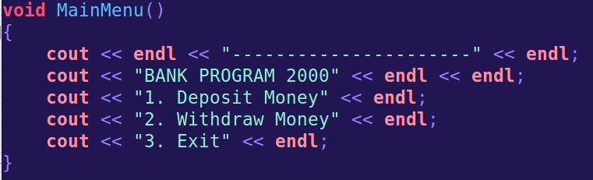
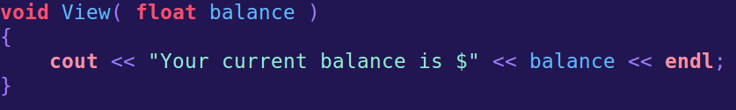
Anatomy of a Function return types
For example, we could store our main menu within a void function,
And display it each time through the program.
Or just format some information before displaying it.

Slide 30
That was a lot to cover, but we're not done yet!
Let's do some programming before we continue!

Slide 31
Scope

Slide 32
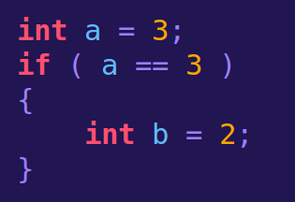
What is Scope?
Scope refers to where a variable or function is available within a program.
b only exists within this if statement.
Outside of the if statement, it does not exist and cannot be used,
Though a different variable with the same name could be created.
A variable declared within a block of code is only accessible within that block.
Think of a block of code as being within curly-braces { }
Such as within an if statement, loop, or function body.

Slide 33
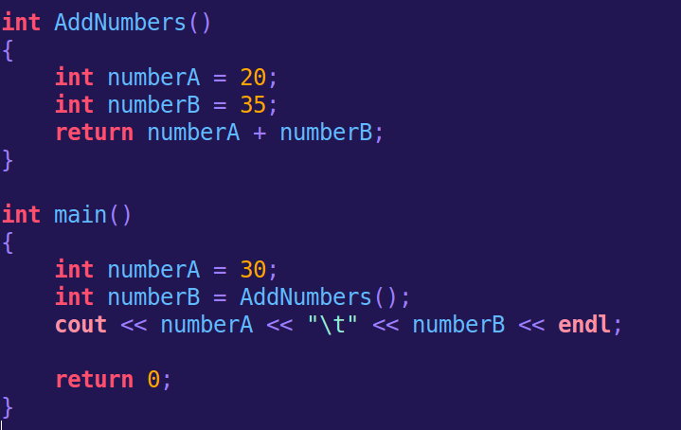
What is Scope?
Variable names can be reused if the scope is different for both.
numberA and numberB here are within the scope of the AddNumbers function.
numberA and numberB here are within the scope of the main function.
Between each function, they are totally different variables, but with the same name.

Slide 34
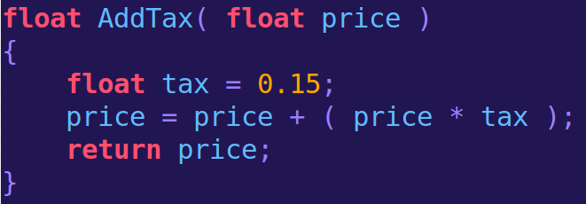
What is Scope?
A variable that is within the scope of some code block is known as a local variable. These variables are only accessible from within this scope.
tax is a local variable of AddTax.

Slide 35
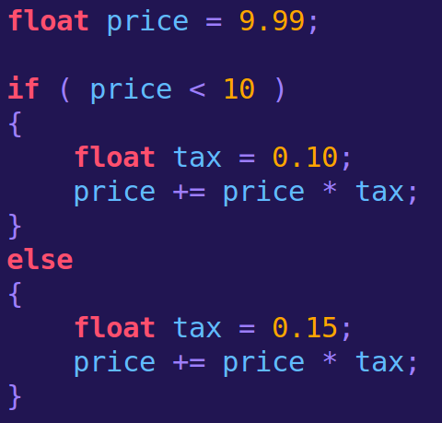
What is Scope?
A variable that is within the scope of some code block is known as a local variable. These variables are only accessible from within this scope.
There are two separate variables named tax, and they have different scope.
One is local to
if ( price < 10 )
And the other is local to
else
And neither is in-scope (neither exists) outside of this if and else statement.

Slide 36
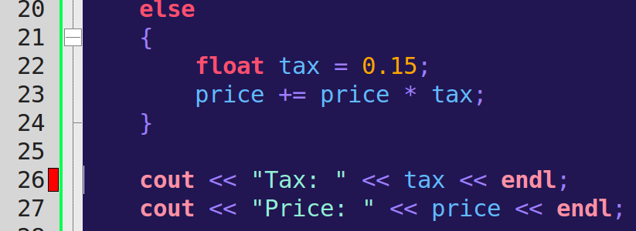

What is Scope?
If we try to use a local variable outside of its scope, we will get a build error (a compile-time error), because the variable does not exist.

Slide 37
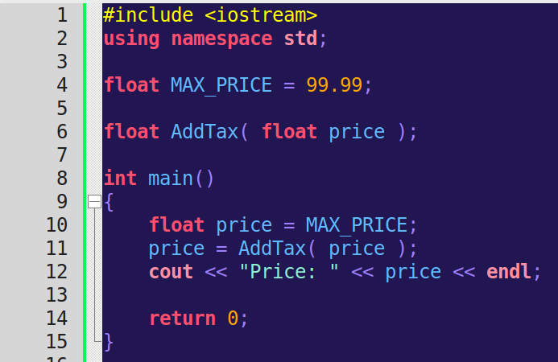
Global Variables
A global variable is declared outside of all functions – including the main() function. A global variable is accessible to all code below it.
Global variable
Using the global variable

Slide 38

Global Variables
Global variables are considered bad practice, and you should avoid them!
Using global variables can lead to...
Hard-to-follow code!
Hard-to-maintain code!
A huge mess!
If you want a variable to be accessible between different functions, you should be passing the variable as an argument!

Slide 39
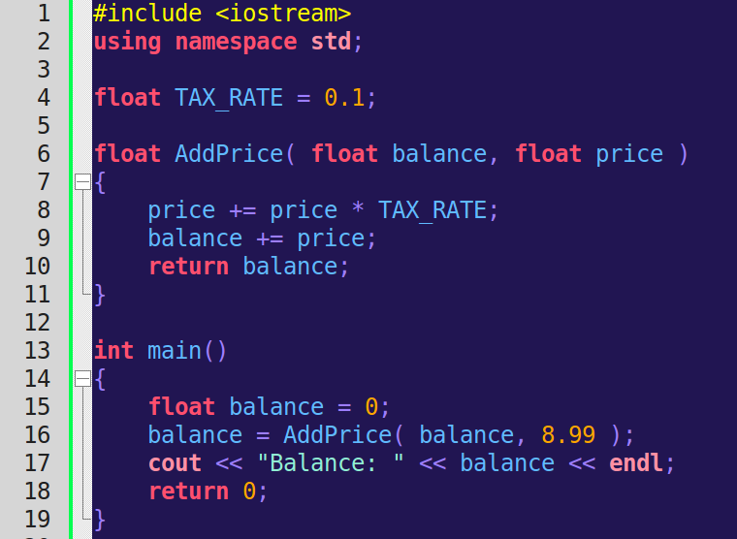
Global Variables
Bad Practice

Slide 40
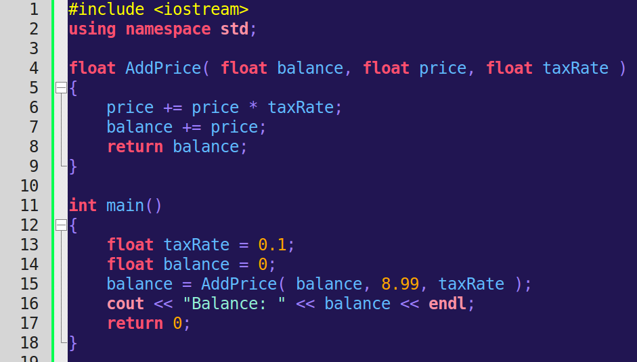
Global Variables
Better!

Slide 41
Global Variables
A global variable is declared outside of all functions – including the main() function. A global variable is accessible to all code below it.
Global variable
Using the global variable

Slide 42
Passing Parameters

Slide 43
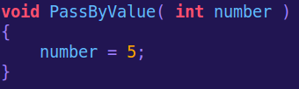
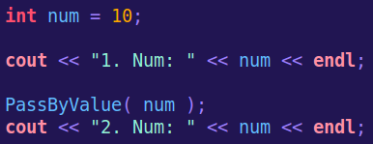

Passing Parameters
When we pass a variable to a function, a copy is made by default.
Any changes made within this function to that variable do not get saved once the variable leaves the function (because it's a copy – not the original!)
This is called passing by value.
We are passing the value of a variable to the function, so that the function can work with it.
When the program returns from the function
(via a return statement or just reaching the end of the function)
The variable will still have its original value.

Slide 44
Passing Parameters
We may want a variable to change within a function.
Or, we may want to return multiple values from the function.
In C++, we can only use return to return ONE value,
But there is another way we can return information from a function.

Slide 45
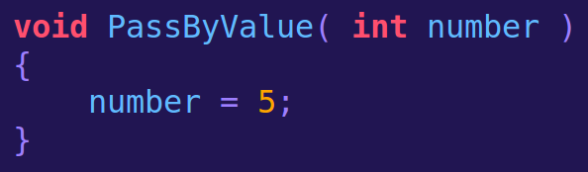
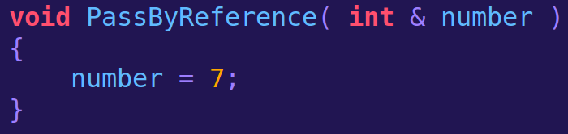
Passing Parameters
If we want to pass our arguments by reference, within our function header, we need to specify those parameters with an ampersand & after the data-type.

Slide 46
Passing Parameters
This is the only thing that changes when passing by reference.
We still use our number variable the same way within the function body.

Slide 47
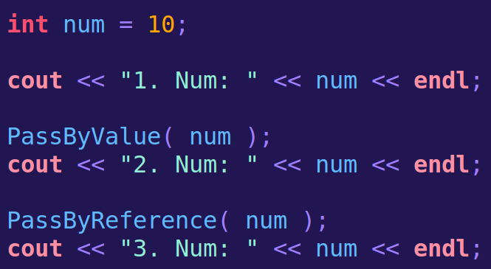
Passing Parameters
We still call our function in the same way.

Slide 48
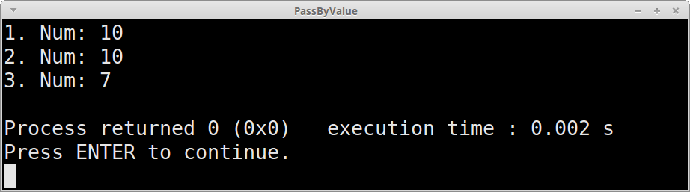
Passing Parameters
In main
After PassByValue
After PassByReference
But now the variable that we pass into the function during the function call gets updated.

Slide 49

Passing Parameters
Let's do some coding to put it into practice!
Let's do some coding to put it into practice!

Slide 50
Passing Parameters
So remember
Pass by Value
And
Pass by Reference

Slide 51

There are a couple more things to cover! Hold tight!

Slide 52
Function Overloading

Slide 53
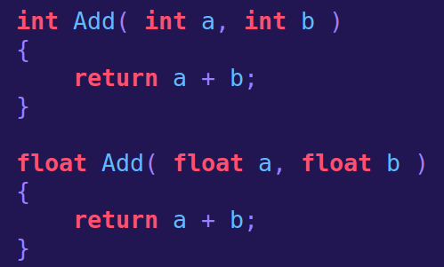
Function Overloading
In C++, we can reuse function names.
This is called
function overloading.
As long as the parameter lists between both functions are different, using the same function name is valid.
C++ won't look at the return type to tell these functions apart, so these don't matter whether they're the same or different.

Slide 54
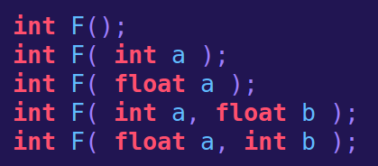
Function Overloading
A function signature is essentially the part of a function header that C++ uses to tell functions apart – The name, and the parameter list.
You can have as many overloaded functions as you wish.
Two functions can be unique if:
They have a different amount of parameters.
If the parameters are different data-types.
If the parameters are in a different order.
C++ doesn't care about the names of the parameters. If the parameters all have the same data-type then it isn't valid.

Slide 55
Function Overloading
Let's do some coding to put it into practice!
Example!

Slide 56
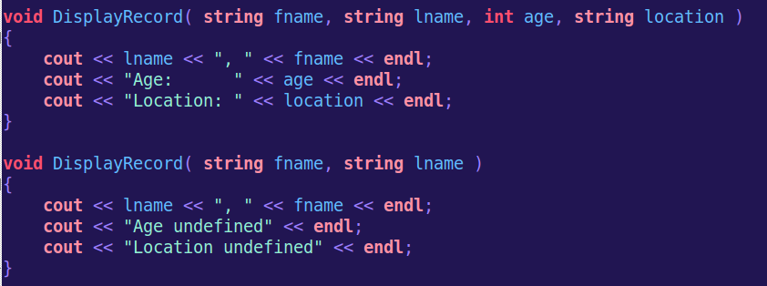
Default Parameters
A default parameter is used to set a default value for a function parameter.
For example, we could use overloaded functions to display a record to a user differently, based on what information is available.
But this might get unruly if we want different ways to display records for any amount of data provided.

Slide 57
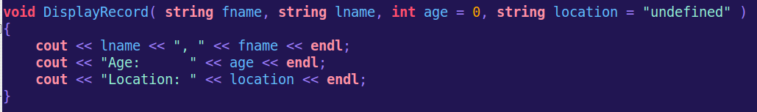
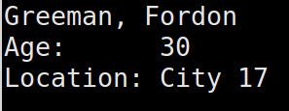
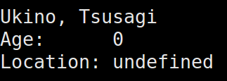
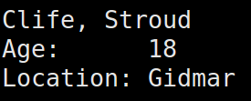
Default Parameters
Instead of overloading this DisplayRecord function, we could reuse the same code and simply set some default values.
We specify the default value by setting the parameter equal to something.
Here, 0 is the default for age and “undefined” is the default for location.

Slide 58
Default Parameters
Instead of overloading this DisplayRecord function, we could reuse the same code and simply set some default values.
The default parameters must go towards the end of the parameter list.
There cannot be any not-default-parameters that appear after
default parameters.

Slide 59
Default Parameters
Let's do some coding to put it into practice!
Example!

Slide 60
That was a lot to cover!
The more you work with functions, overloading, default parameters, and passing by reference, the better you will get with it.
Here are some more sample programs that you can use to get a feel for these topics.

